Slide 1
B4B - Build For Broadband Webinar
Broadband Technology 101
June 13, 2019 Presenter: Joanne Hovis, CTC Technology and Energy

Slide 2
B4B - Build For Broadband Initiative
Practices that support access to competitive, high-speed broadband for the current and future connectivity needs of Seattle residents.

Slide 3

Seattle B4B
June 13, 2019
Broadband Infrastructure 101
© CTC Technology & Energy 2019

Slide 4
Agenda
Where We Are
The current state of broadband technology
Where We’re Going
Wireline
Wireless
Satellite
How we got here

Slide 5
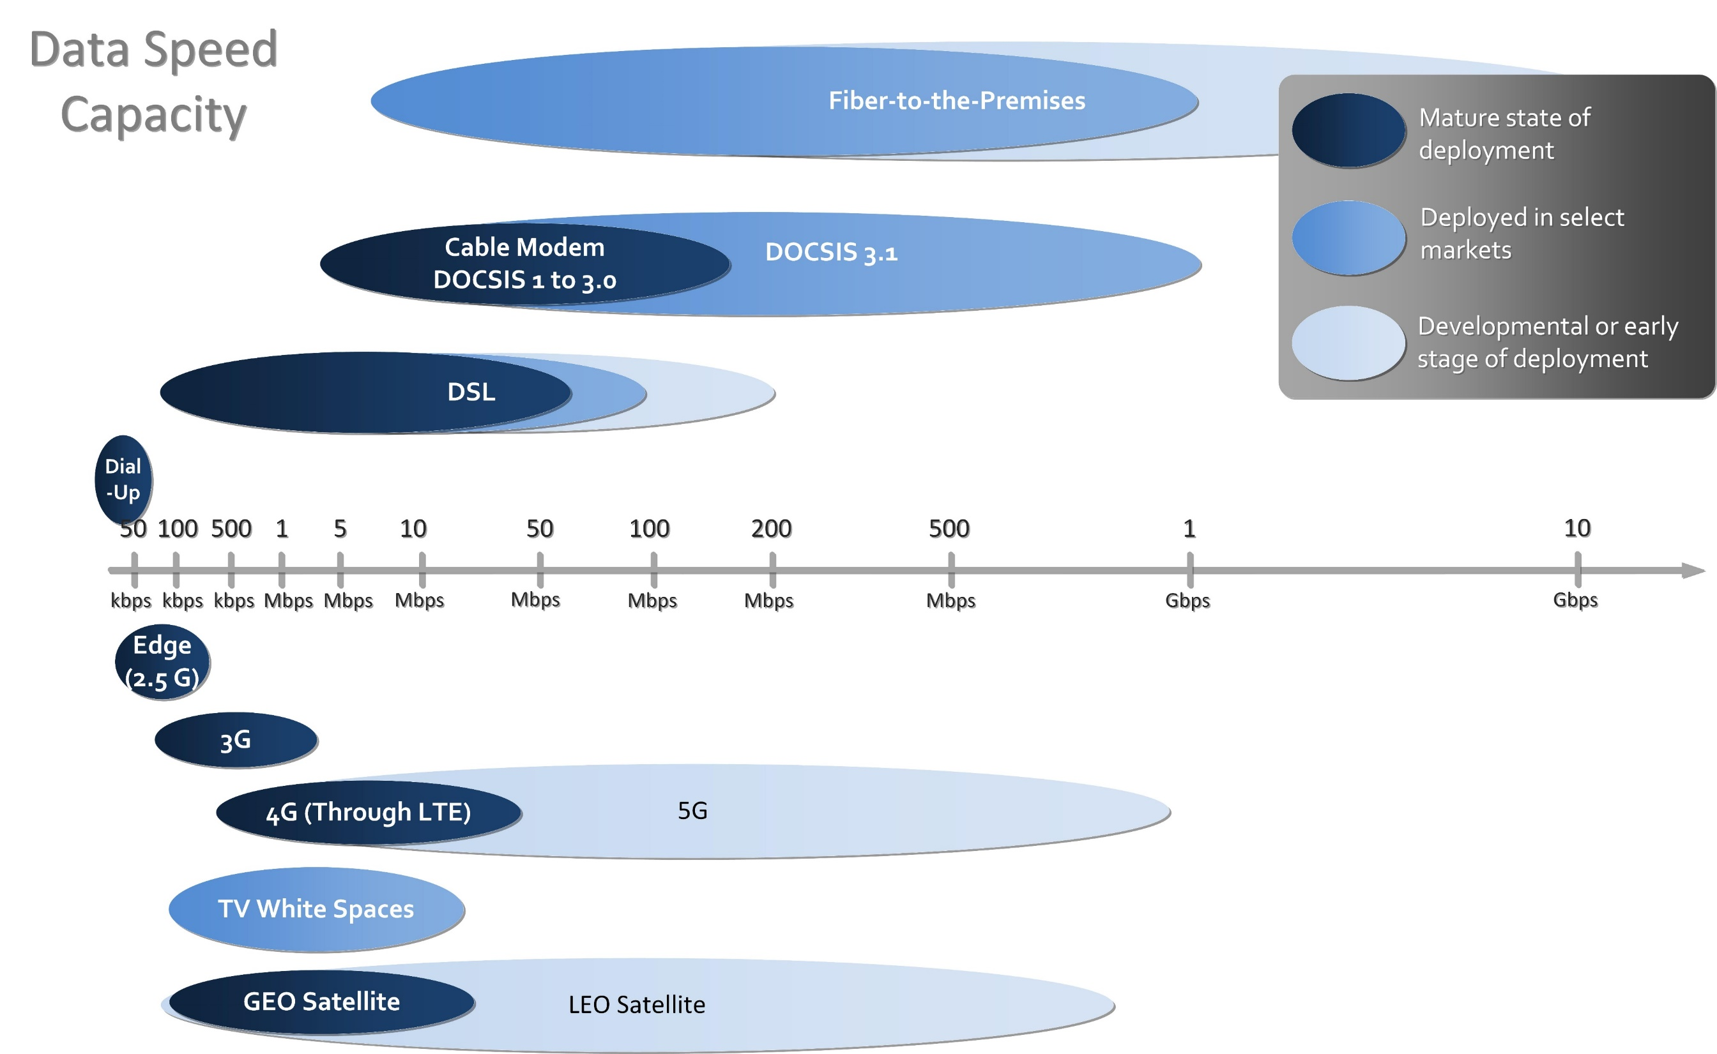

Slide 6
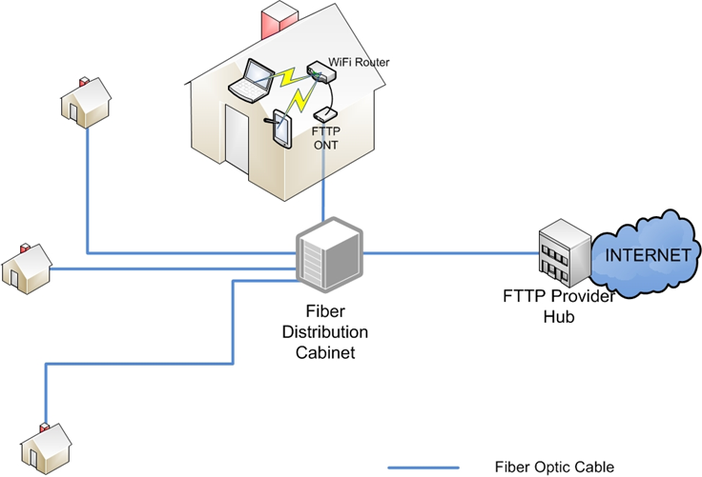
Fiber-to-the-Premises (FTTP)

Slide 7
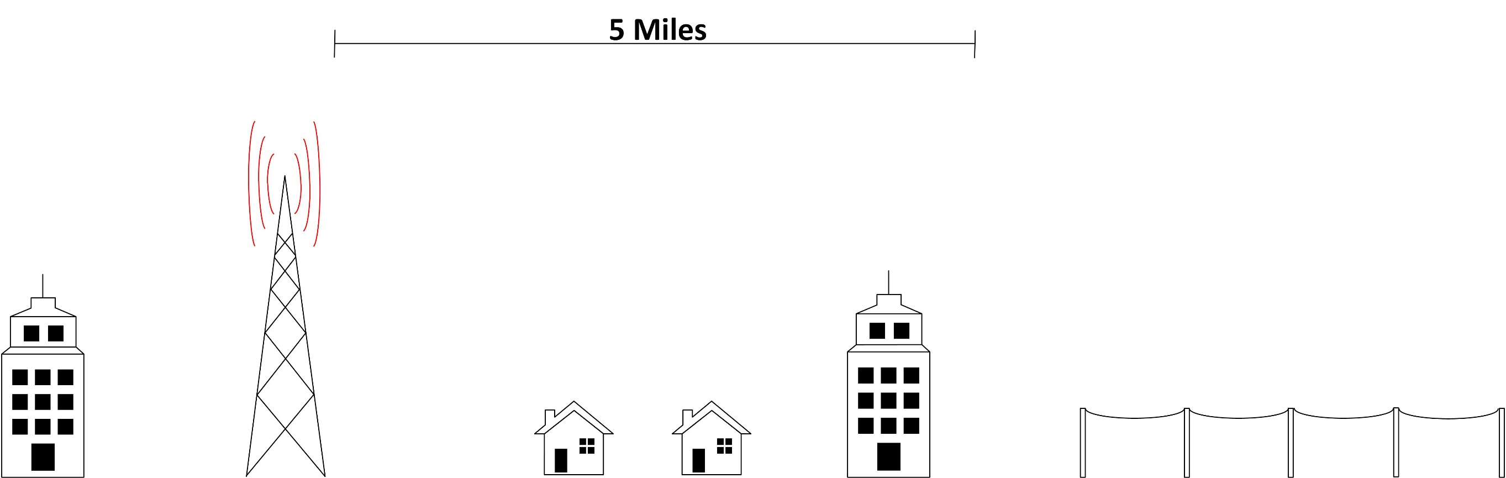
1G/2G
1990s urban/suburban
2000s/2010s rural
Voice, text
Low-speed data
Antennas on towers & some buildings
Microwave & copper backhaul

Slide 8
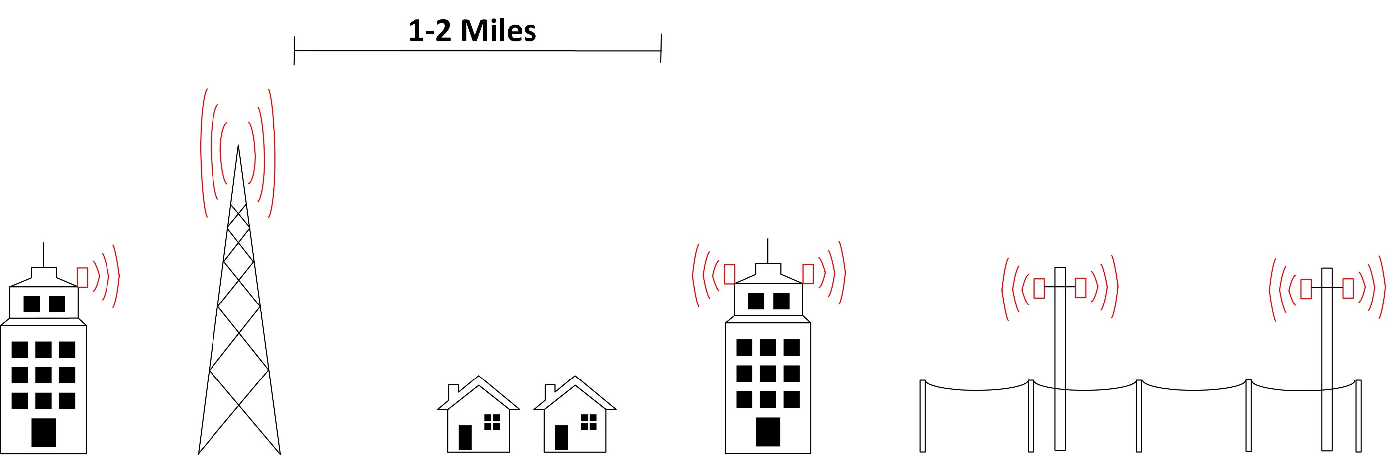
3G
2000s urban/suburban
2000s/2010s rural
Voice, text
Medium-speed data
Antennas on towers & buildings
Fiber or microwave backhaul, copper in some areas
Closer and denser antennas
Fewer users per antenna

Slide 9
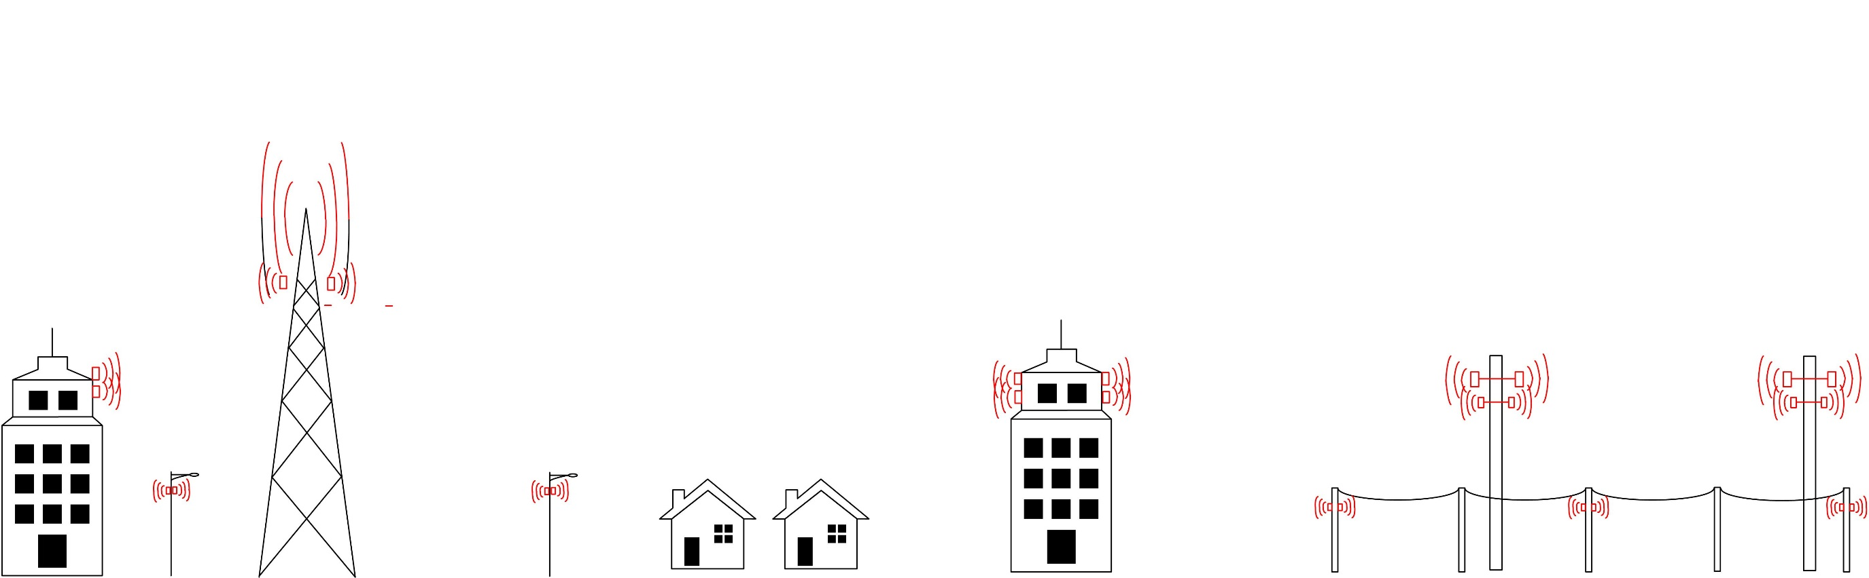
4G
2010s urban/suburban, some rural
Voice(VoIP), text (IP)
Smartphone service, speed few to 50 Mbps
Antennas on towers, poles and buildings
Multiple spectrum bands on antenna
Backhaul fiber, occasional wireless
Closer and denser antennas depending on density of users
Every few hundred feet in urban areas
Indoor DAS

Slide 10
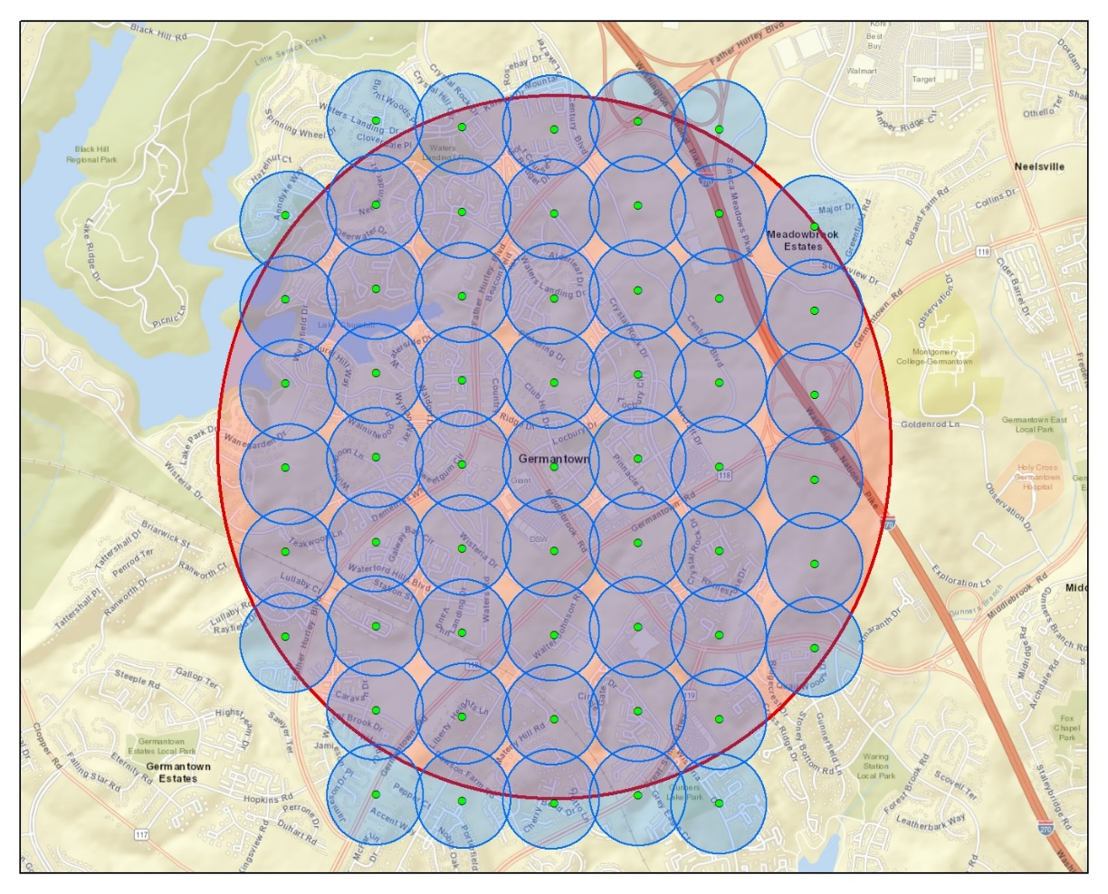
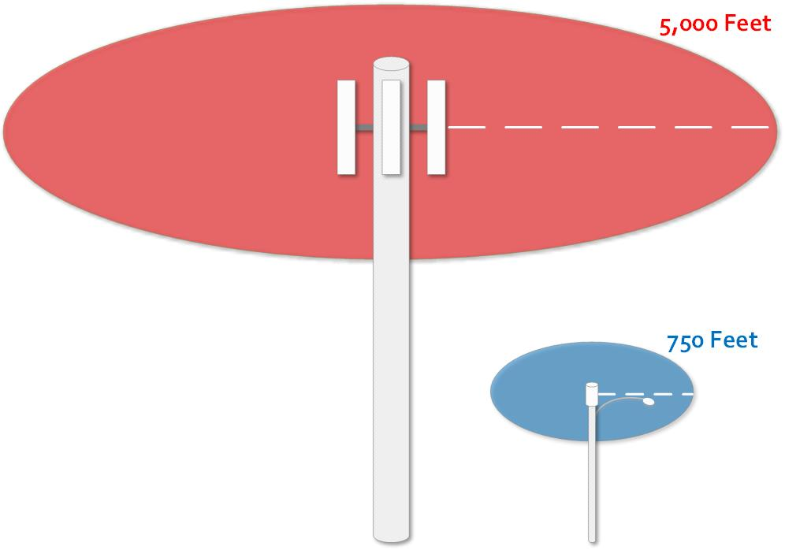
4G Densification
Small cell sites added where needed to boost capacity

Slide 11
Trends to understand
5G does not yet exist
Current small cell land (pole) rush is for 4G “densification”
“5G” is marketing and lobbying term
Almost any new wireless deployment is being called “5G” regardless of whether it aligns with 5G definition or standards
Risk that hunger for hyped “5G” will trump other considerations and local process
Small cell deployment entails safety, interference, and other challenges
Requires utility oversight

Slide 12
Technology categories: 2 forms of wireless to consumers
Mobile wireless
Travels with us around town & around the country
Service purchased is designed for mobility first (with speed a lesser goal)
Comes with a price—usually slower and less reliable than “fixed”
Fixed wireless
Attempts to replace a wire—is a service to a particular location
Effort to compete with (or alleviate need for) cable or telco connection

Slide 13
5G technical challenges
Large scale deployment still speculative
Early pilots underway but little data available
Gigabit speeds will require mmWave spectrum
mmWave spectrum has problematic propagation characteristics
Requires line-of-sight or close proximity
Cannot penetrate walls/go indoors (so will require use of other, slower spectrum)
Fast speed will require
Dense infrastructure (ie, poles and antennas)—not cost-justified in rural areas
Fiber every few hundred feet in typical urban/suburban area—very high cost

Slide 14
5G economic challenges
High cost of deployment + fiber
Unclear what the potential is in urban/suburban
No business case in rural areas
Wall Street thus far unconvinced
Market opportunity not yet apparent
Fixed: Verizon pilots panned; AT&T holding back for now
Will compete with cable’s huge advantages
Mobile: Unclear whether consumers will pay more
Enormous incremental cost to deploy but modest incremental revenues (ie, 5G customers are not new customers; they are converted 4G customers)

Slide 15
5G timeline & development path
Still in development stages
Emerging in coming year or two
Deployment path unclear
Fixed: Verizon suggesting imminent deployment in some urban areas
Mobile: Some deployment in 2020 for urban/suburban
Neither mobile nor fixed deployment in rural, other than on major highways (possibly)
Even best case deployment will be uneven
Standards-writing underway
Manufacturing path uncertain & pricing undetermined
Focused on “high value” areas
Service available only to some locations
Likely increase in rural/urban and have/have not divides

Slide 16
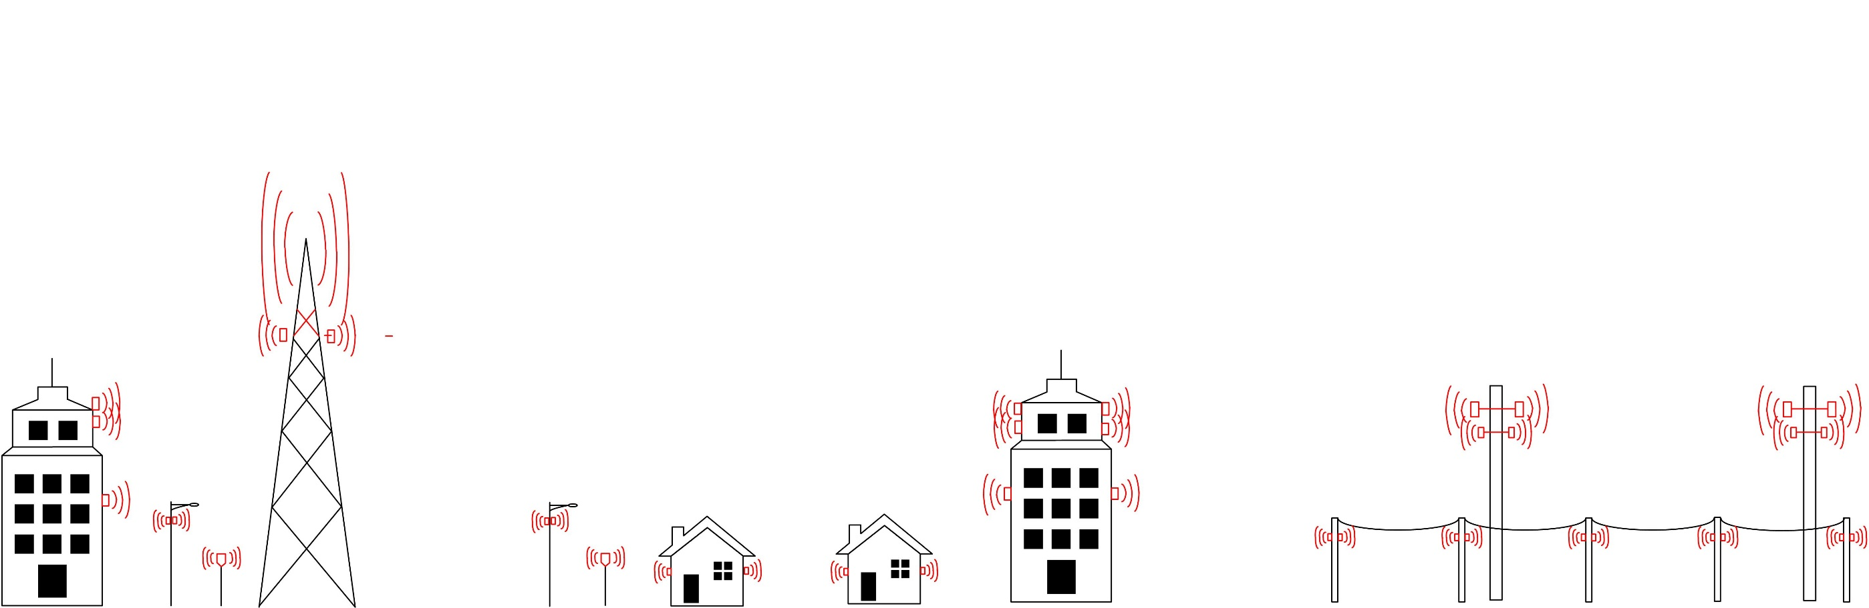
Potential 5G
2020 projected urban/suburban, unclear for rural
Few hundred Mbps to Gbps (higher speeds require mmWave)
Mixture of small & large multiple spectrum antennas
Fiber every few hundred feet
Closer and denser antennas depending on density of users
mmWave requires line-of-sight or close proximity
No building penetration

Slide 17
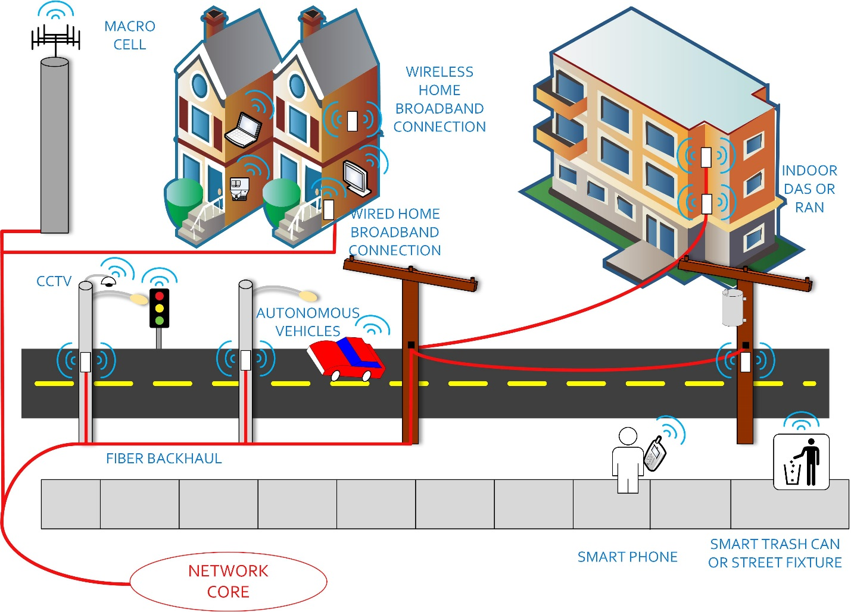
Emerging 5G architecture
Millimeter wave spectrum requires direct line of sight
Radios every two utility poles
Indoor & outdoor radios
Widespread fiber

Slide 18
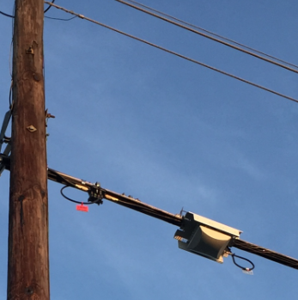
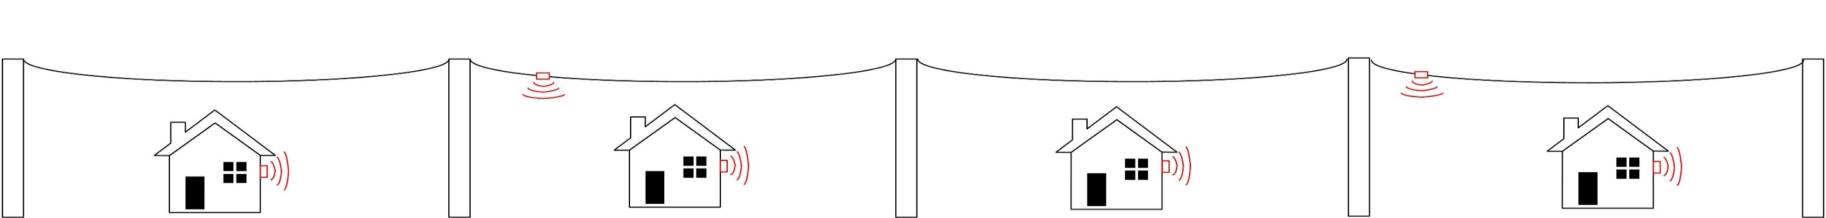
Cable cos poised to compete with 4G/5G in mobile
Cable modem products now available
Marketed as Xfinity Mobile, Spectrum Mobile etc
Spectrum
Uses WiFi and other unlicensed and lightly licensed
May soon use CBRS (3.5 GHz) and licensed (600 MHz)
Backhaul
Uses existing cable (hybrid fiber/coax) networks as community-wide backhaul networks
National footprint emerging
Roams to other cable networks in other cities and to carrier mobile network in rural areas

Slide 19
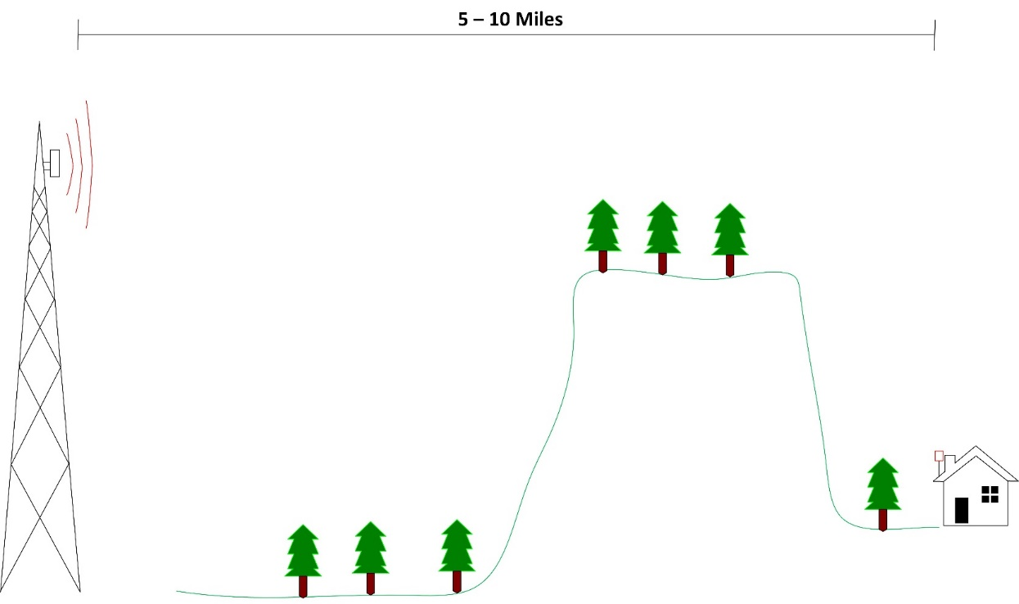
Alternative rural wireless technologies
TV White Spaces
can complement unlicensed
well suited for terrain and foliage
spectrum widely available in rural areas
long range may reduce need for fiber

Slide 20
Alternative rural technologies
Unlicensed spectrum
5 GHz similar to WiFi
Longer-range 3.5 GHz CBRS spectrum potentially emerging
60/70/80/90 GHz mmWave for high-speed and backhaul
Unlicensed and lightly licensed, augments fiber
Large advantage to infrastructure owners
Cable companies on existing attachments
Power companies on existing poles
Potentially low cost, low barrier to entry

Slide 21
Satellite broadband potential
Historic challenges
Latency
Deployment (and service) cost
Bandwidth limitation
Potential opportunity
Move from GEO to LEO
Reduction in deployment costs

Slide 22
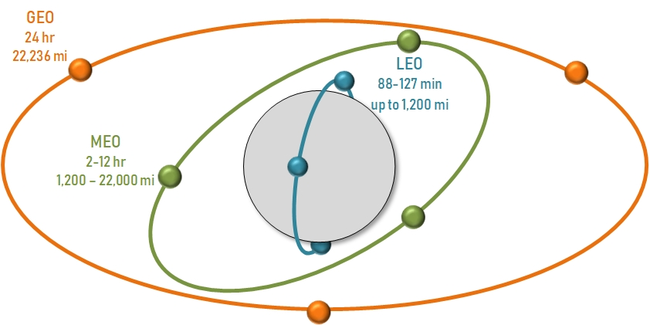

Slide 23
Satellite broadband: orbit and latency
 | Orbit | Broadband speed | Latency
Geostationary Hughes Viasat | 22,236 mi | 2 to 30 Mbps down Far less up | 600+ ms
Low earth orbit SpaceX Telesat OneWeb | up to 1,200 mi | ? | 25+ ms

Slide 24
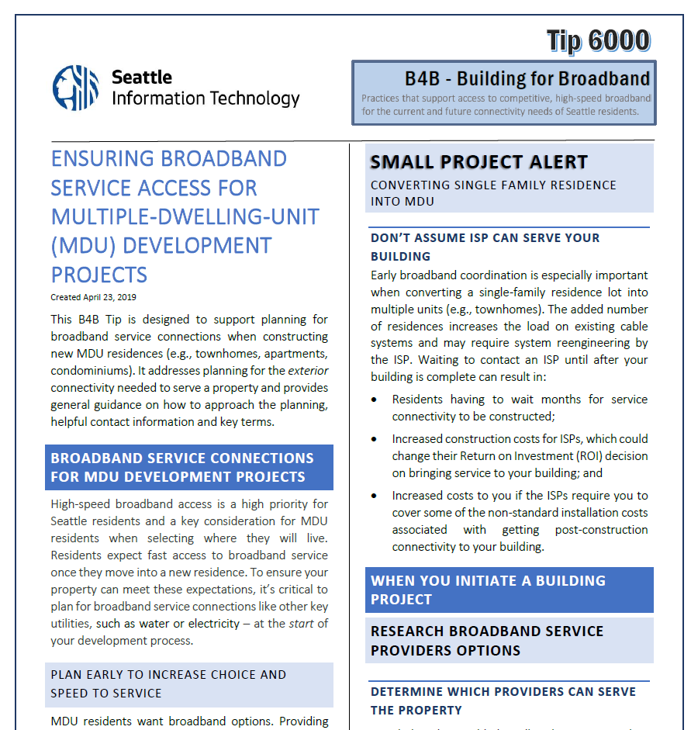
B4B-Building For Broadband Initiative
Building Community Awareness
Early Telecommunication Planning
Benefits of Infrastructure Investments
Tips
Website
Webinars
Planning problems magnified by trying to design for something that’s hard to predict
www.seattle.gov/tech/initiatives/broadband/build-for-broadband
Notes:
Focus is building awareness w Builders
MDU survey found owners
confused on their choices,
reliance on old models built from cable TV days.
Shift to to utility model. They own, ISPs light it up.
Information from Hannah and Kurt is what bldg. owners need to
Better understand options
TIPS work thru permitting, newsletters, direct outreach
Worked w ISPs
Website add access resources of interest and support to builders/owners questions.
Webinar: lay groundwork and be source of neutral info for decision making

Slide 25
www.seattle.gov/tech/initiatives/broadband/building-for-broadband
Thanks for Participating!
Alice Lawson, Broadband & Cable Program Manager, alice.lawson@seattle.gov
Notes:
Thanks
Email me with questions
Or lessons learned – resource ideas to share w Seattle MDU community
Especially newer solutions used to increased speeds and option in your older brownfield properties.
To Kurt

