Slide 1
Regional Transportation Plan 2026-2050
Seattle Bicycle Advisory Board
May 19, 2026

Slide 2
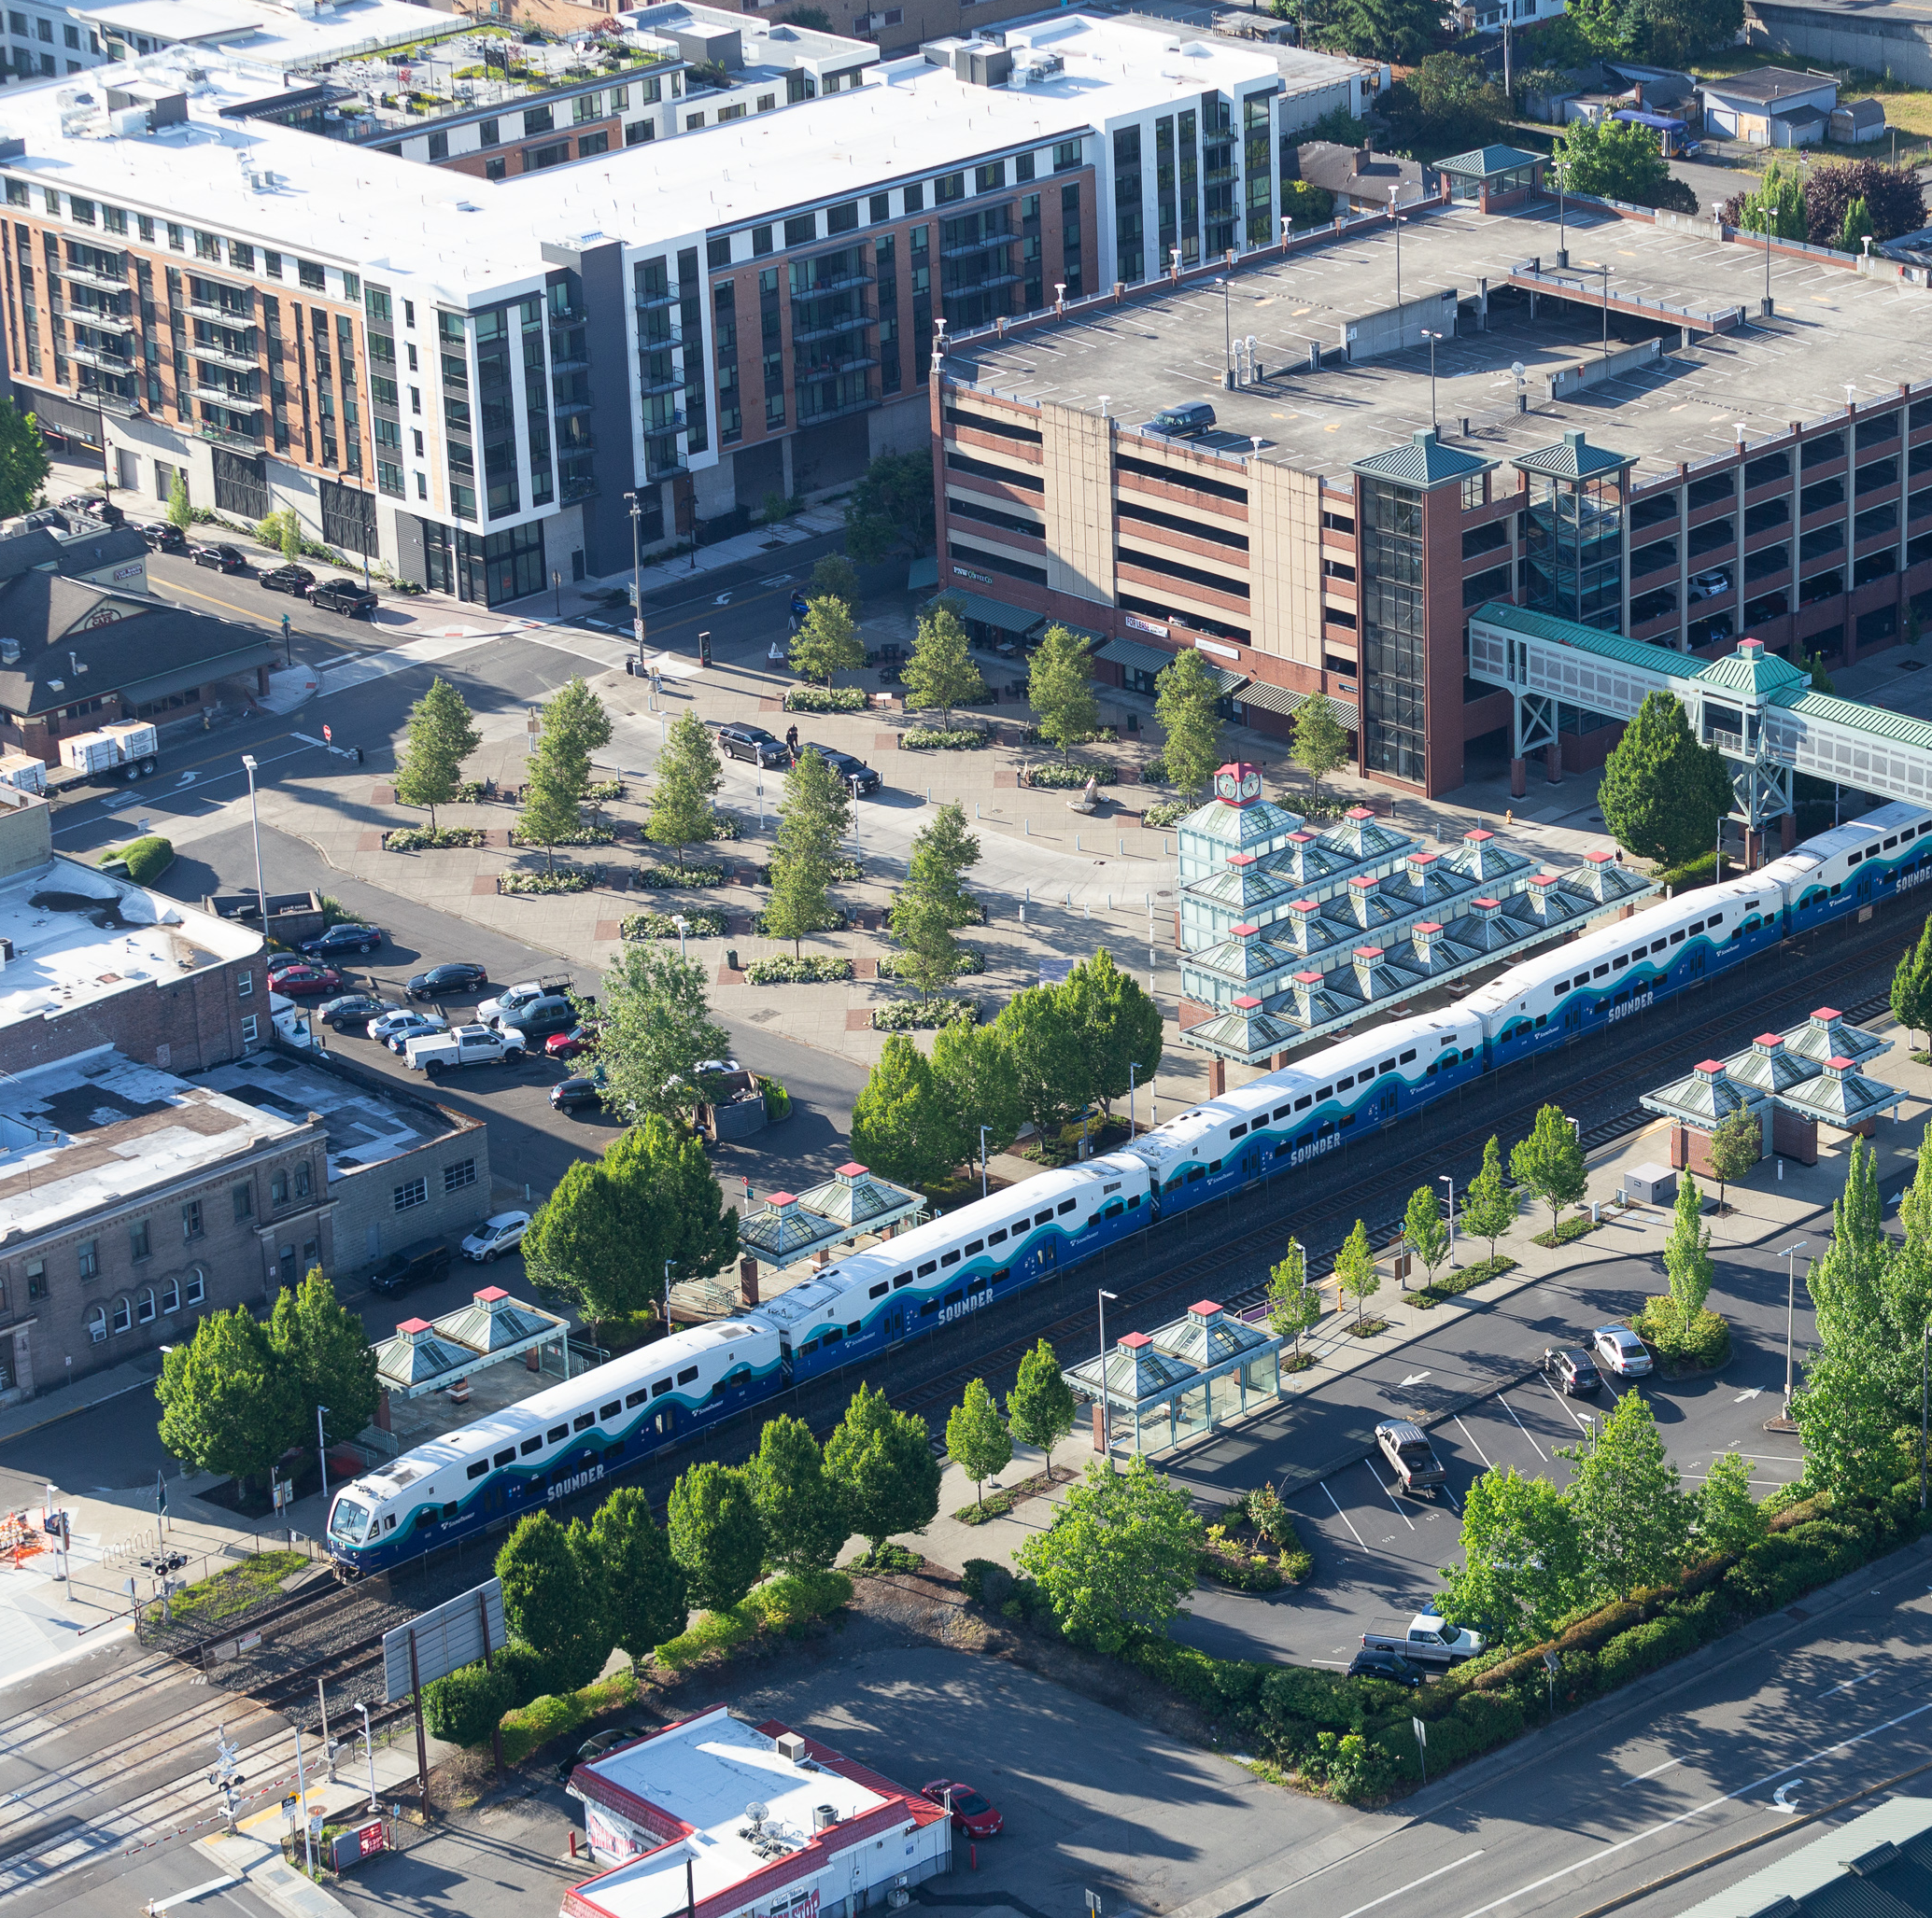
Today
We will talk about…
PSRC and our role
Regional Transportation Plan
Active Transportation Plan

Slide 3

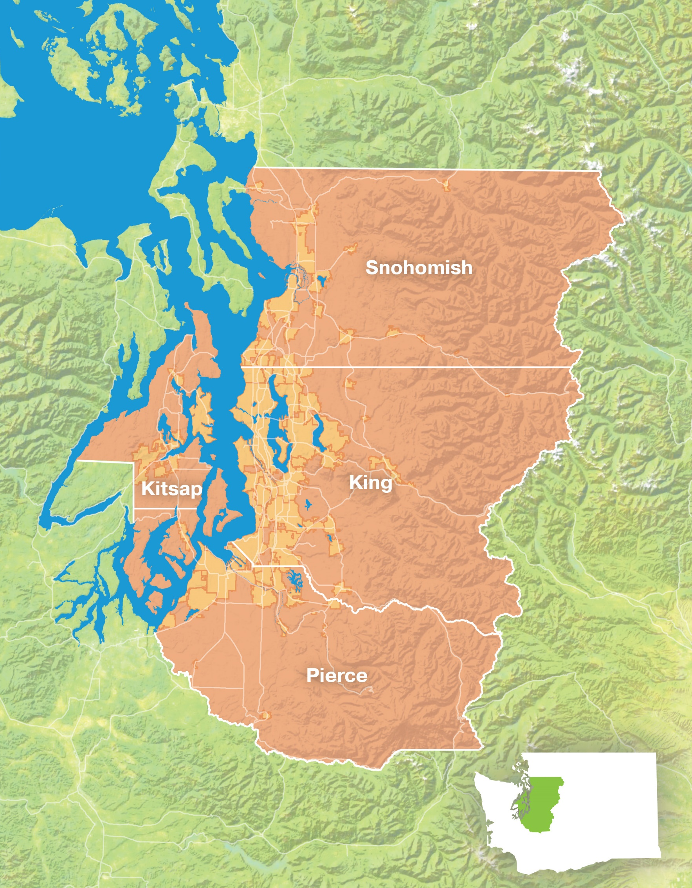
Who are we?
Metropolitan Planning Organization
Coordinates transportation, economic development, land use planning, and more
King, Kitsap, Pierce, and Snohomish counties (4.5 million people)
Members include 82 cities and towns & 9 transit agencies
Notes:
4.3 million is what is in our most recent Demographic Profile (October 2024) – number is based on American Community Survey 2022 1-Year estimates.

Slide 4
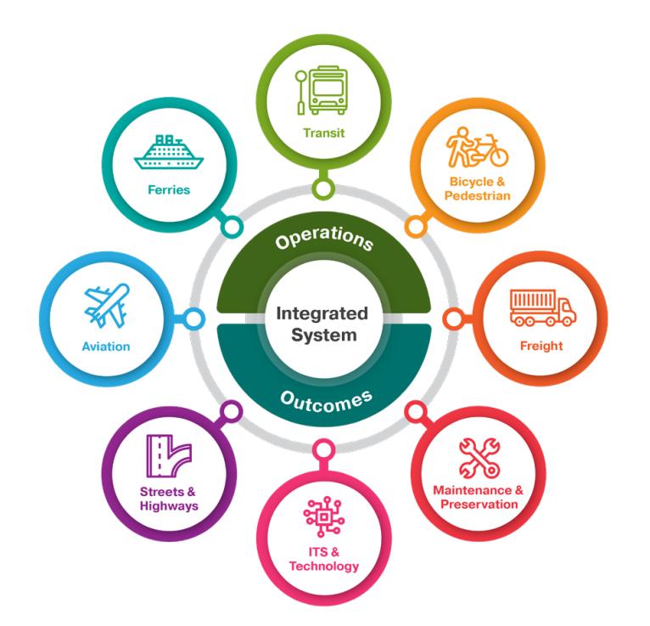
What is a Regional Transportation Plan?
Lays out the region’s long-term transportation needs and goals.
Developed collaboratively with cities, counties, transportation agencies, and the public.
Updated every four years according to state and federal requirements.

Slide 5
Plan Priorities
Working with PSRC’s member agencies and the public, key priorities identified for the next plan include:
Safety
Climate
Equity
Transit & Accessibility
Recognize Diverse Needs and Community Context
Maintenance & Preservation
Decarbonize the System
Financial Strategy
Ferry System Service & Reliability
5
Notes:
GIL

Slide 6
2026-2050 Plan Development: What’s New
Investments based on new comprehensive plans, current transit plans, new State Highway System Plan
Updated plan consistency framework applied to all regional capacity projects
Evaluation of four plan scenarios
Reassessment of financial strategy
Regional Safety Action Plan
Regional Comprehensive Climate Action Plan
Project selection to follow plan adoption
6

Slide 7
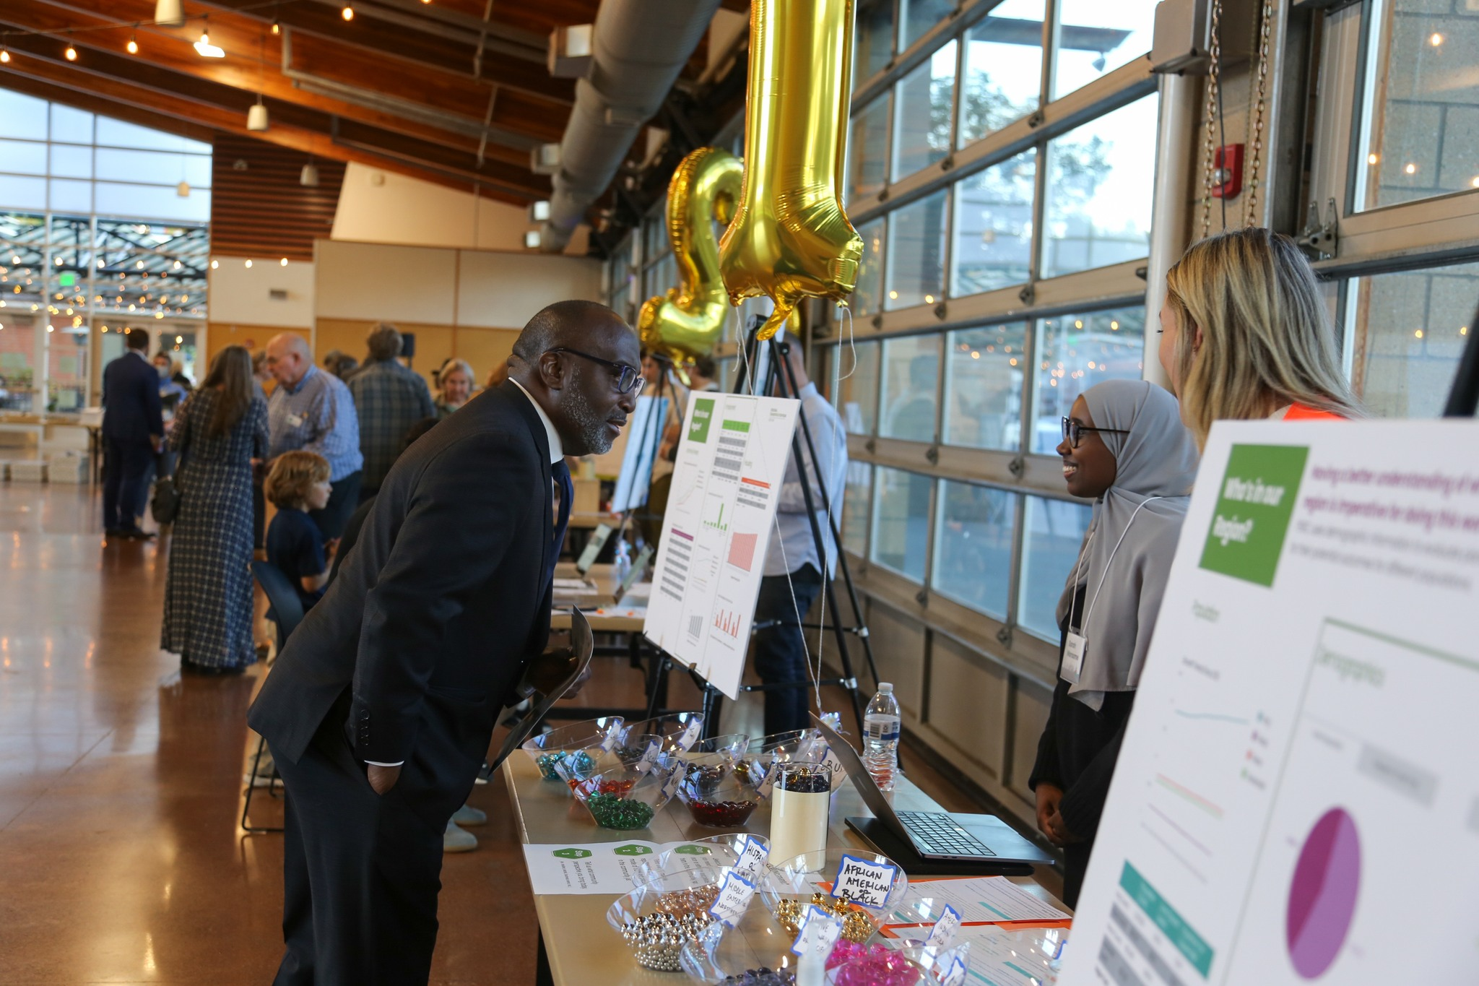
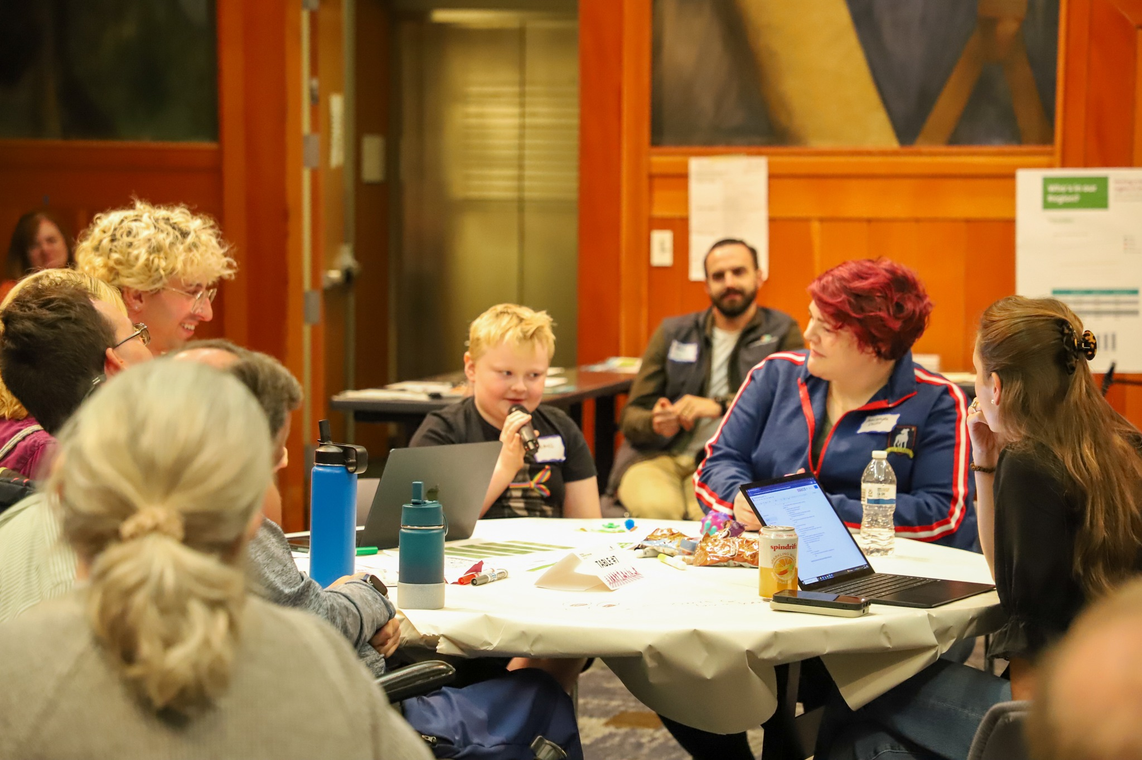
Continuous Public Outreach – 2025/2026
Spring – Summer
  Community Tabling
Spring – Fall
  Online Survey Open
  Fall 7 Regional Public Meetings
  >600 total participants
Winter
  Draft 12/15-2/2 comment period
7

Slide 8
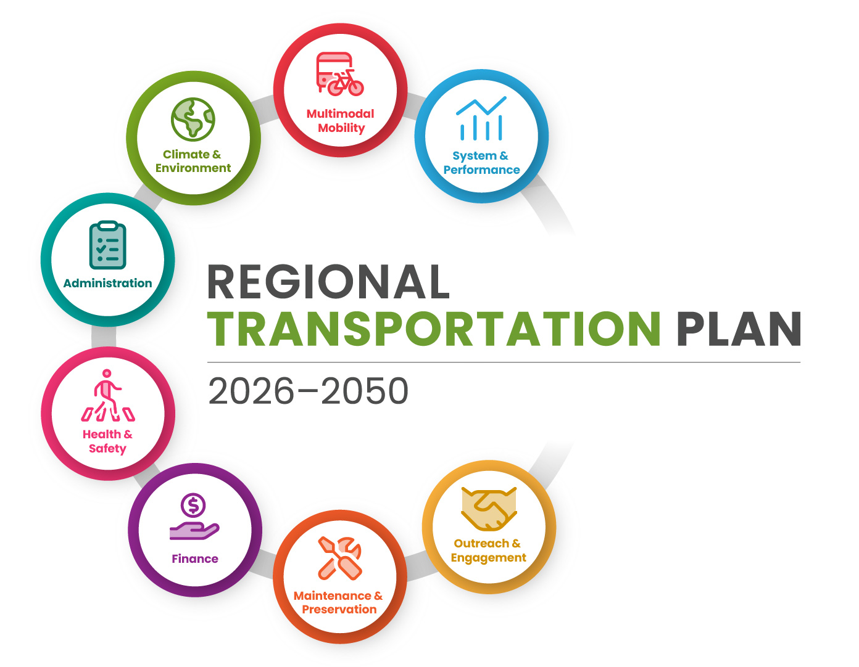
Draft Plan – Elements and Approach
Streamlined plan document
Summary of plan results and key findings
Actions and future work
Links and standalone documents for key plan elements
Notes:
GIL

Slide 9
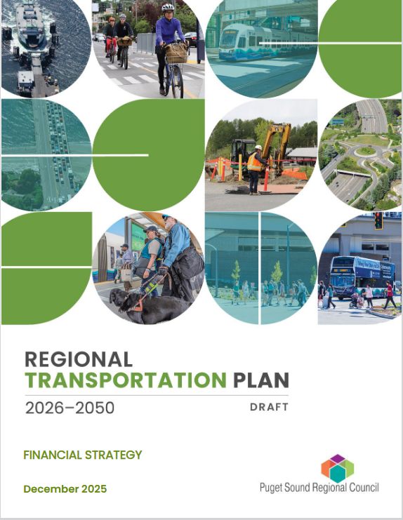
Draft Plan – Available Documents
Examples of available documents and topics:
System Performance Report
Transportation System Visualization Tool
Freight Story Map
Active Transportation Plan
Climate & Resilience
Water Quality
Health
Safety
Financial Strategy
Maintenance & Preservation
9
Notes:
GIL

Slide 10
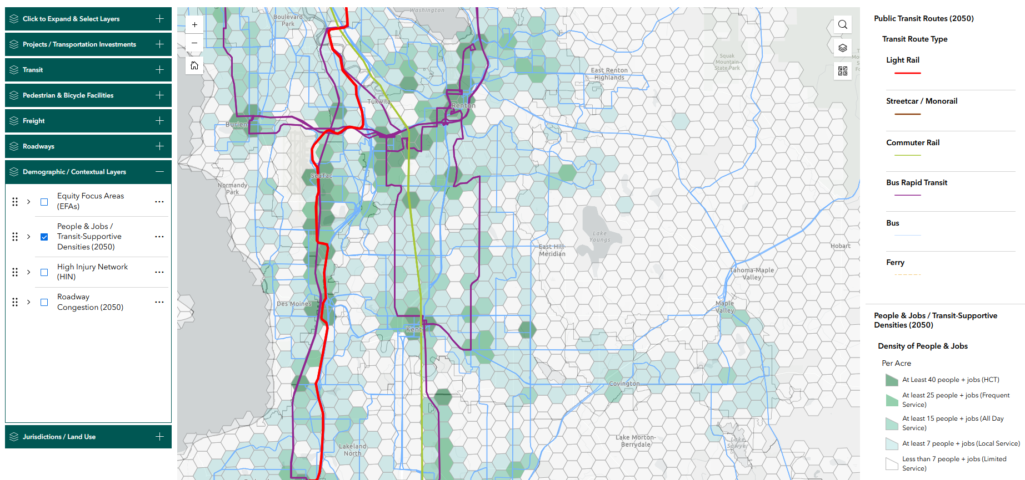
Transportation System Visualization Tool
10

Slide 11
Plan Highlights
$335 billion total cost - includes a wide mix of needed investments with a focus on maintenance and transit
  83% of plan costs can be funded with current law revenues
  Fully funding backlog, maintaining state of good repair into the future (60% of plan costs)
  Significant expansion of regional and local transit networks and service
    116 miles of light rail, doubling of bus rapid transit routes, 90% increase in transit service hours

Slide 12
Plan Highlights
Significant progress on regional priorities
  33% growth in people and jobs by 2050
  20% growth in total VMT, 12% reduction in VMT per capita
  An almost tripling of transit trips by 2050
  Walking and biking trips grow 83% and 58%, respectively
  83% reduction in greenhouse gas emissions

Slide 13
Plan Action Items
Transportation Finance – ongoing work program to advance transportation funding options, particularly to address local needs
Maintenance and Preservation – continued work to improve estimation methodologies and data collection
Climate – advance implementation of the Comprehensive Climate Action Plan; advance work to address climate impacts and vulnerabilities of the transportation system

Slide 14
Plan Action Items
Future system gaps – explore opportunities to address gaps in the future system, e.g. addressing transit gaps in alignment with the 2030 VISION and RTP update
Safety – advance implementation of the Regional Safety Acton Plan
Plan also identifies future planning work “On the Horizon”

Slide 15
Public Comments Received
Over 60 respondents provided public comment on the plan, categorized into 332 unique comments
Comment themes include:
Active Transportation - 11
Climate and Environment – 26
Funding - 26
General / Other - 130
Roads and Maintenance - 33
Safety – 29
Technology - 5
Transit - 72

Slide 16
Processing of Comments
Of the 332 unique comments:
86 technical corrections made to the final plan
  Clarifications, minor corrections
15 comments reviewed by board and resulted in new action items for future PSRC work programs
  Rural transportation issues
  Ongoing performance measurement and monitoring
  Transportation technologies

Slide 17

2026 Draft Active Transportation Plan
Draft ATP Content:
Introduction and Scope of ATP
Expanded info from the RTP Current Transportation System Report
Expanded info from the RTP Future Transportation System Report
Next Steps / What’s Ahead?
  Overview of related work
  Plan implementation items/actions

Slide 18
Draft ATP – Current System Content
High-level outputs on travel behavior for walking, biking, and rolling in the region from the Household Travel Survey.
Overview and analysis of the Pedestrian and Bicycle Facility Inventory
  Mileage and coverage in different geographies
  Overview of the Pedestrian and Bicycle High-Injury Network (HIN)
  Level of Traffic Stress (LTS) and Gap Analyses
ADA Transition Plan Inventory

Slide 19
Draft ATP – Future System Content
Explanation of the RTP Regional Capacity Project (RCP) List and programmatic active transportation investments
Overview of the pedestrian and bicycle elements of the Regional Capacity Projects.
Some information on how these projects address the identified gaps and the Pedestrian and Bicycle High Injury Network (HIN).
Model outputs on mode share, trip purposes, and median time/distance spent walking and biking in 2050.

Slide 20
Draft ATP – Next Steps and What’s Ahead
The ATP lists these implementation actions to help guide our pedestrian and bicycle work program.
Continue to maintain and improve regional pedestrian and bicycle data collection and reporting
Work with external partners to monitor progress on work relevant to active transportation
Continue to provide guidance and support for local jurisdictions in the form of data, tools and relevant plans
Explore ways to further integrate the plan into PSRC’s project selection process
See the full list on Page 26 of the Draft ATP

Slide 21
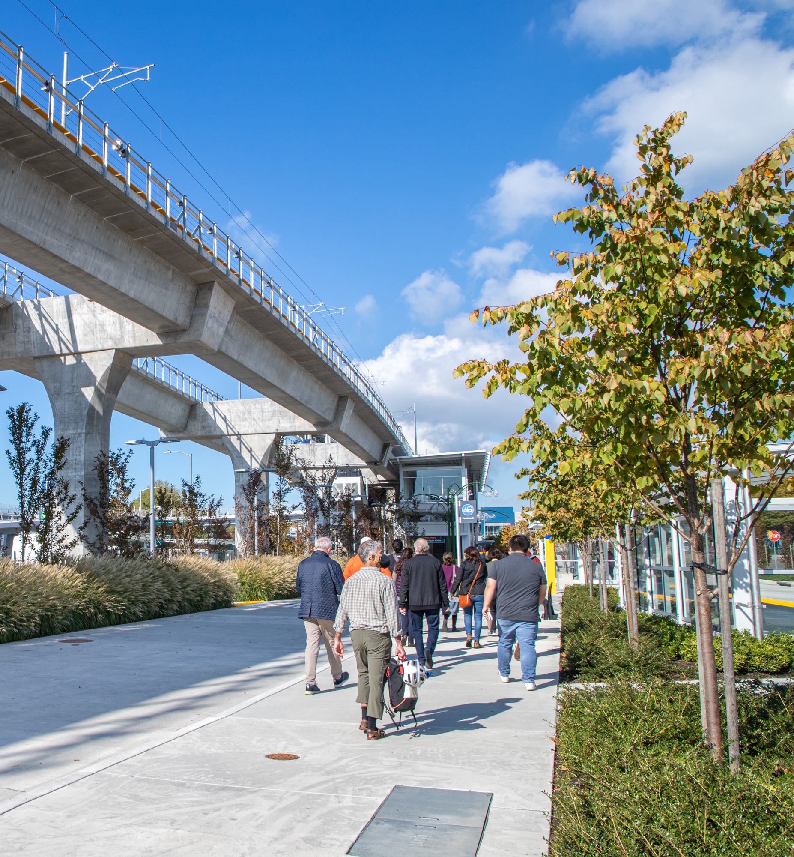
Other relevant work from the Draft RTP
Coordinated Mobility Plan
Describes how transit agencies, human service agencies, school districts, and other transportation providers can work together to improve mobility for people with mobility and accessibility needs
Regional Transit Access Assessment
Identifies where work is taking place to develop tools and resources for current and future transit access planning efforts. (Work Ongoing)
Health and Safety Reports
These reports describe how the draft RTP addresses safety and public health.

Slide 22
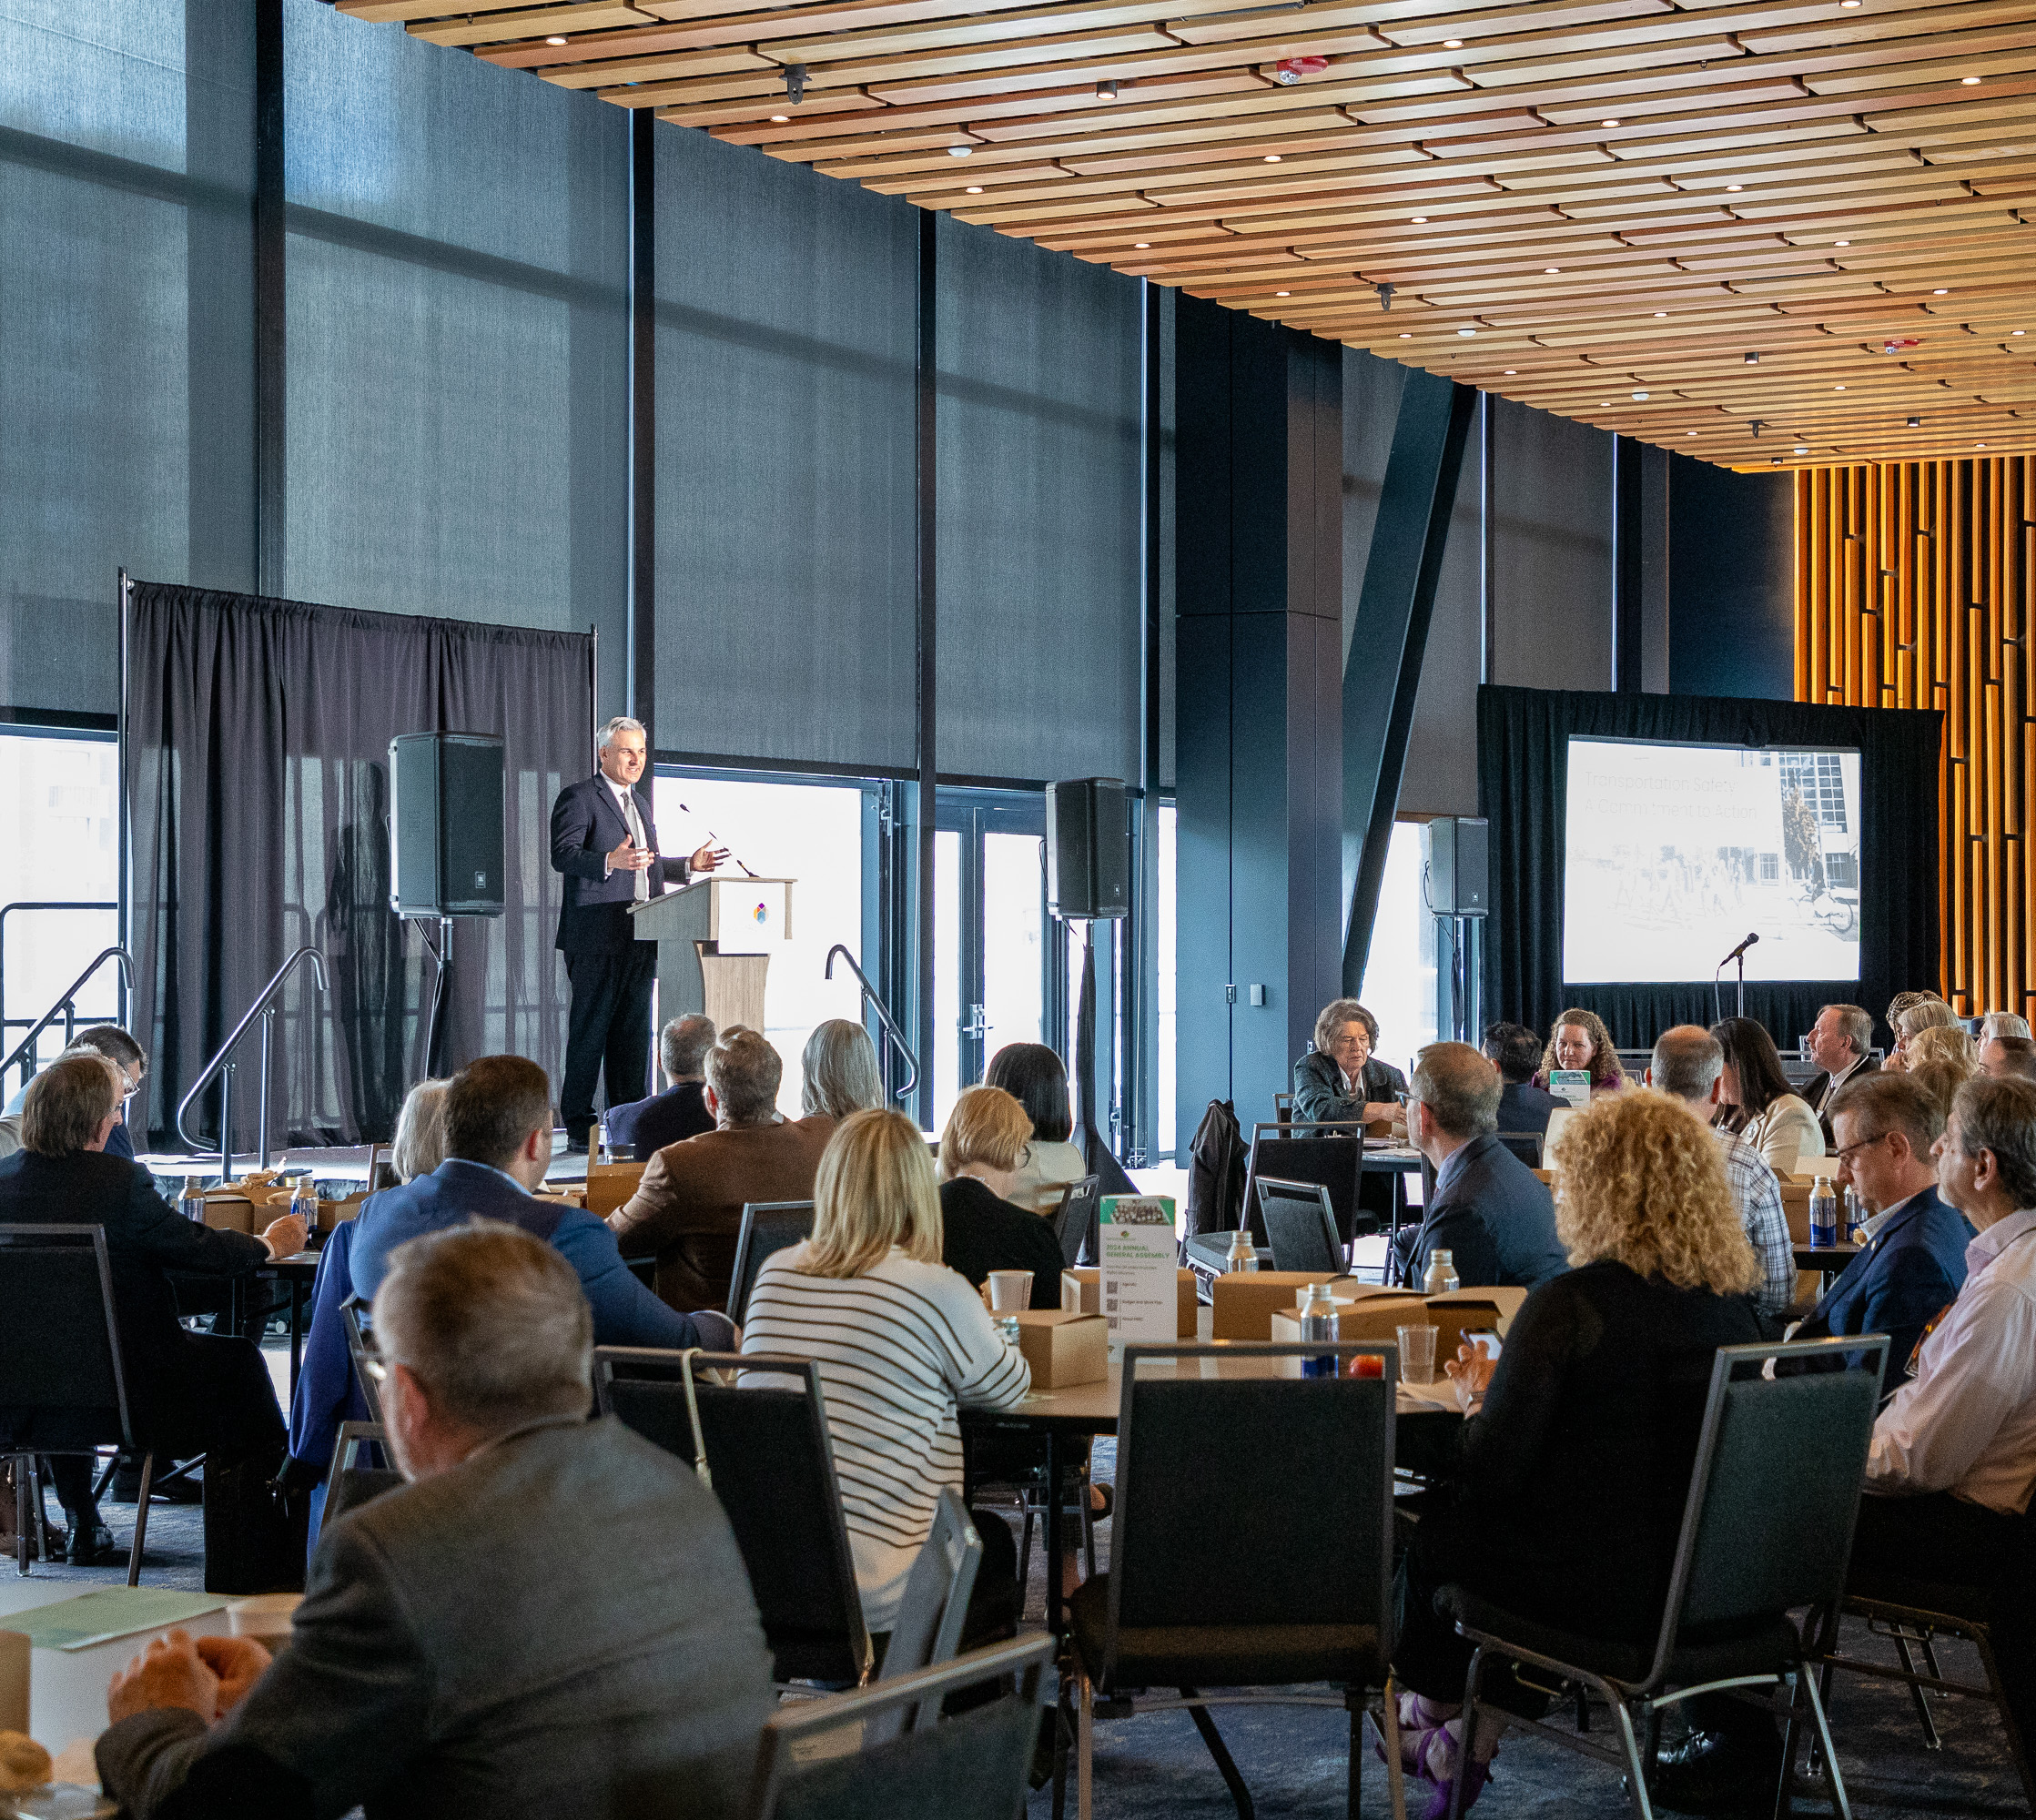
Schedule to Plan Adoption
May 28th, 2026
General Assembly plan adoption

Slide 23
Thank You!
Gil Cerise
Program Manager, Transportation Planning
gcerise@psrc.org (206) 971-3053

