Slide 1

Open Public Meetings Act
(OPMA) Training
For Boards, Commissions, and Committees
June 2026
Presented By:
Gary Smith, Assistant City Attorney (Government Affairs Section Director)

Slide 2
Purpose of this Training
(Washington State Open Public Meetings Act, Chapter 42.30 RCW)
The OPMA in one sentence:
Meetings of the City of Seattle’s governing bodies (the City Council, Council Committees, and Boards/Commissions/Committees) must be open to the public, unless exceptions apply.
Why are we doing this?
  You are members of a “governing body” under the OPMA.
  Such training is mandatory under state law after you take office.
  Refresher training is required every four years.
  Transparency obligations – See OPMA Legislative Purpose.

Slide 3
Purpose of the OPMA
(First Adopted in 1971)
The State Legislature sets forth the OPMA’s purpose in RCW 42.30.010, including:
All public commissions, boards, councils, committees, subcommittees, … and all other public agencies of this state … exist to aid in the conduct of the people's business.
Their actions are to be taken openly and their deliberations are to be conducted openly.
The people of this state do not yield their sovereignty to the agencies which serve them.

Slide 4
Purpose of the OPMA (continued)
(First Adopted in 1971)
The people … do not give their public servants the right to decide what is good for the people to know and what is not good for them to know.
The people insist on remaining informed and informing the people's public servants of their views so that they may retain control over the instruments they have created.
For these reasons, even when not required by law, public agencies are encouraged to incorporate and accept public comment during their decision-making process.

Slide 5
Potential Consequences for Violating the OPMA
As a general matter, OPMA violations can lead to a loss of public trust in the City’s commitment to transparency and open government.
Any ordinance, resolution, rule, regulation, order, or directive adopted at an illegal meeting is null and void.
OPMA violations could potentially serve as a basis to remove a member of a board, commission, or committee from that governing body.
A court could impose individual penalties for knowing violations:
  $500 fine for the first violation
  $1,000 for any subsequent violation
  Costs and attorney fees

Slide 6
What is a Meeting?
“Meeting” means meetings at which the governing body takes “action.” RCW 42.30.020.
In practice, a meeting is:
  A gathering of a quorum (i.e., a majority) or more of the board, commission, or committee; and
  At such a gathering, the participating members of the governing body have the collective intent of transacting the business of the board, commission, or committee.
By extension, key questions to consider are:
  Is there a quorum of the board, commission, or committee participating in the gathering?
  If so, do those members have the collective intent to transact business on behalf of the board, commission, or committee?

Slide 7
“Meeting” – Further Considerations
The OPMA can apply even if a quorum of the governing body gathers by email, telephone, or video conference.
If the prerequisites for a meeting are present (i.e., a quorum and the collective intent to conduct business on behalf of the governing body), the gathering is a “meeting” under the OPMA, regardless of how it is titled (e.g., workshop, retreat, study session).

Slide 8
Action
“Action” means the transaction of the official business of the board, commission, or committee on behalf of the City.
It includes but is not limited to:
  Receipt of public testimony, deliberations, discussions, considerations, reviews, evaluations, and final actions.
The requirements of the OPMA can apply even if the governing body is not taking final action on a matter. (See upcoming slide on “Final Action.”)

Slide 9
Final Action
“Final action” means a collective positive or negative decision, or an actual vote, by a majority of the governing body, on a motion, proposal, resolution, order, or ordinance.
“Final action” can also occur via a subcommittee of a board, commission, or committee if that subcommittee is acting on behalf of the governing body.
Secret ballots are prohibited.
Final action must occur publicly in open session.
“Final action” has significance as well related to public comment requirements (see upcoming slide).

Slide 10
Regular Meetings
Regular meetings are recurring meetings held in accordance with a periodic and fixed schedule as established ordinance, resolution, bylaw, or rule.
  The agenda must be posted online to a City website at least 24 hours in advance.
  The agenda can be modified subsequently.
  There are no restrictions on legally transacted business.
  Public comment may be required (see upcoming slide).

Slide 11
Special Meetings
  A Special meeting is any other type of meeting of the board, commission, or committee which is not a Regular meeting.
  May be called by the presiding officer, OR by a majority of members of the board, commission, or committee.
  It is permissible under the OPMA for a majority of the members of a board, commission, or committee to communicate with each other for the limited purpose of scheduling a special meeting.

Slide 12
Special Meetings (continued)
  Notice for a Special meeting must be provided at least 24 hours in advance of the meeting.
  A key difference between a Regular meeting and a Special meeting is that for a Special meeting:
    Final disposition (i.e., final action) shall not be taken on any matter that is not included on the agenda that is published 24 hours in advance of the meeting.

Slide 13
Rolling or Serial Meetings
  Such an unlawful meeting can occur if “action” is taken by a majority of the board, commission, or committee, even if the members are not in the same place at the same time.
  A key consideration is whether the members at issue had a collective intent to meet to transact the governing body’s business.
  Communication exchanges between board, commission, or committee members on social media can implicate the OPMA.
  Passive receipt of information is acceptable (see upcoming slides).

Slide 14
Serial Meetings & Drafts
  Recommendations related to situations in which members of a board, commission, or committee (i.e., “governing body” or “body”) are working on a draft document:
    It is legally acceptable for a subcommittee or working group of less than a majority of the body to work together on a draft document and to communicate with each other about it.
    The draft from that subgroup can then be included on a meeting agenda for the full board, commission, or committee to consider and discuss at an open public meeting.
    In such a situation, the intent would be that the subgroup’s draft would be a recommendation for the full body to consider, with the understanding that the recommendation from the subgroup is purely advisory.

Slide 15
Serial Meetings – Practice Tips
    Passive receipt of information via email is permissible, but work from the presumption that discussion of board/commission/committee business via email by a majority of the governing body constitutes a meeting.
    A one-way email to a majority or more of your colleagues on the board/commission/committee is allowable when the message is to provide, for example, only documents or factual information, such as emailing a document to all members for their review prior to the next meeting.
    Regarding such a one-way communication, have the first line of the email clearly state: “For informational purposes only. Do not reply.”

Slide 16
Serial Meetings – Practice Tips (continued)
    Unless for informational purposes only, don’t send an email to all or a majority of the governing body, and don’t use “reply all” when the recipients are all or a majority of the members of the governing body.
    Alternatively, instead of emailing materials to your colleagues on the governing body in preparation for a meeting, have a designated staff member email the documents or provide hard copies to each member.
    A staff member can communicate via email with members of the governing body in preparation for a meeting, but the staff member needs to take care not to share any email replies with the other members of the governing body as part of that email exchange.

Slide 17
Meeting Formats
Required – Physical Meeting Locations:
  Absent an emergency, in-person attendance must be an option for the public.
  All board, commission, or committee members can attend remotely if the rules or bylaws of the board/commission/committee allow for such participation.
Remote attendance is in addition to, and not instead of, in-person attendance at meetings.
  If remote attendance is allowed, it should be free and offer real-time observation and participation.
  Allow for telephone or other electronic means to access the meeting (e.g., video via computer and internet).

Slide 18
Public Attendance at Meetings
A board, commission, or committee cannot require:
  Attendees to register their name and other information, to complete a questionnaire, or otherwise fulfill a condition precedent to their attendance.
However, the governing body may:
  Adopt generally applicable conditions determined by the governing body to be reasonably necessary to:
    Protect the public health or safety, or
    Protect against interruption of the meeting.

Slide 19
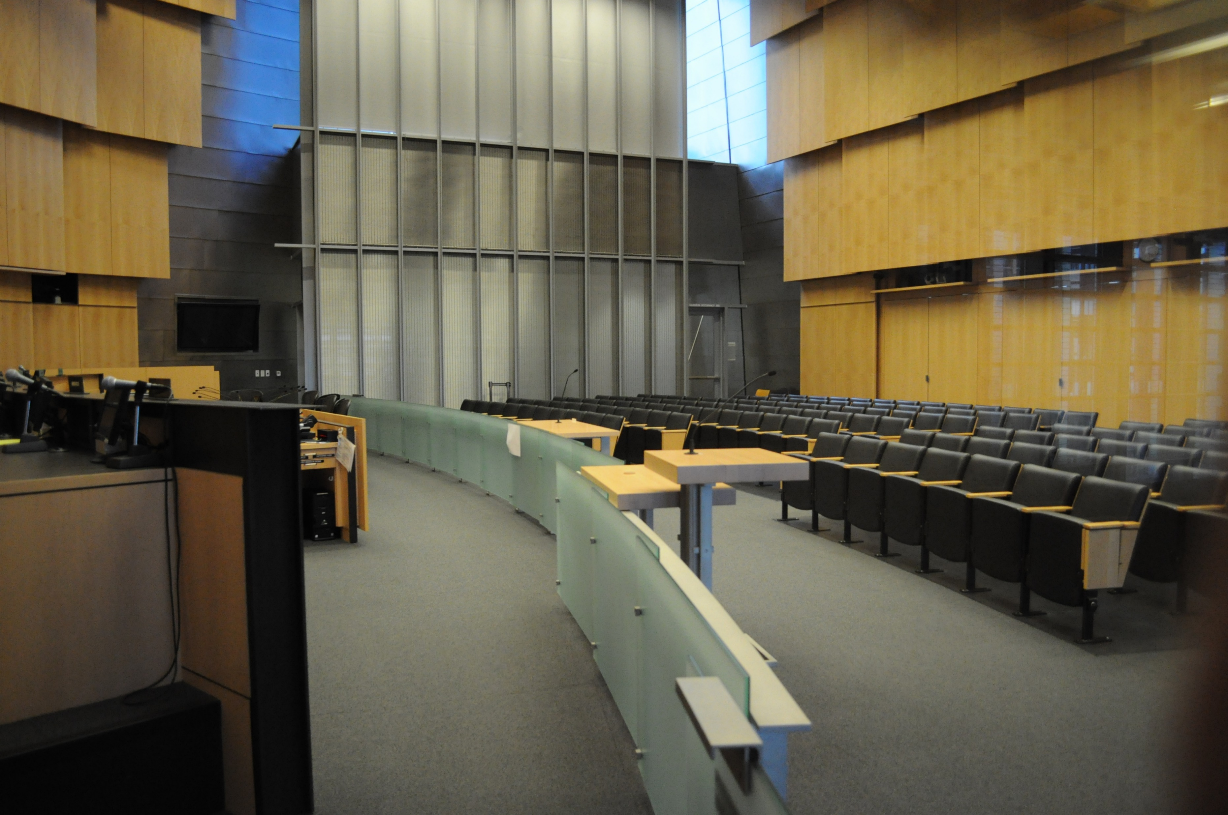
Public Comment
Public Comment is required for regular meetings at which “final action” is taken (see previous slide on that topic).
The decision tree on the next slide provides helpful guidance.
The governing body is authorized to deal with interruptions, and is not required to accept public comment that renders orderly conduct of the meeting unfeasible.

Slide 20
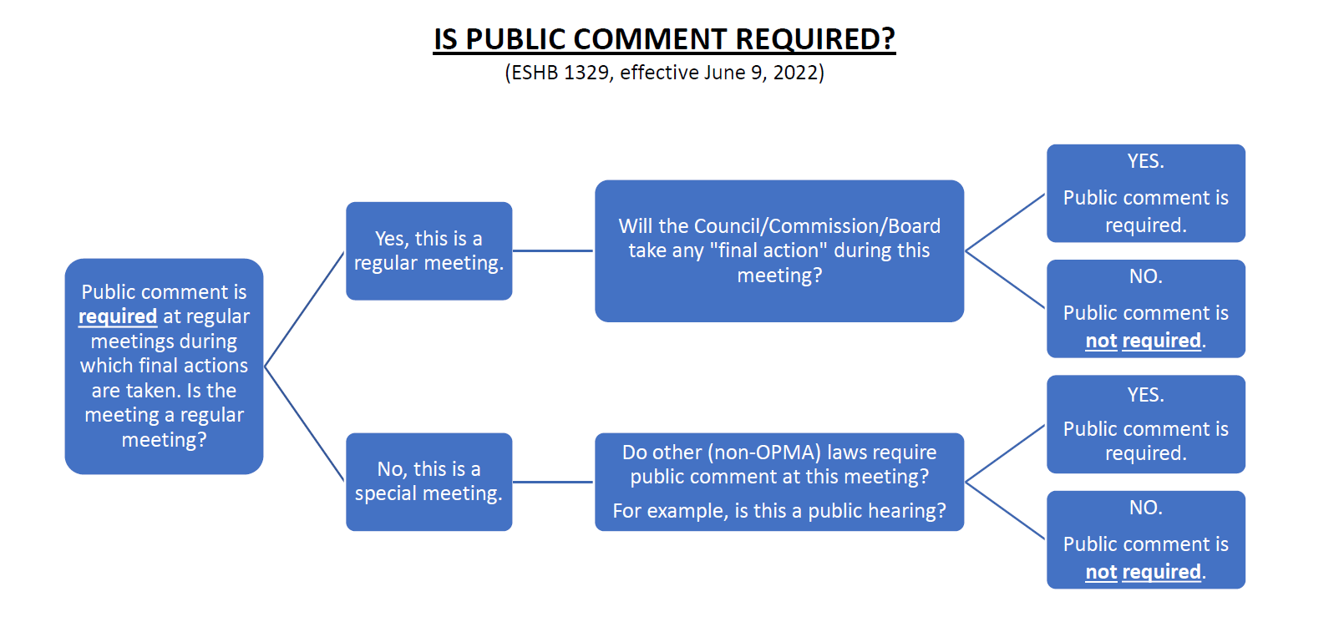

Slide 21
Executive Session
Not open to the public.
Confidential, with or without attorneys.
Part of a regular or special meeting.
Only allowed for the specific purposes set forth in RCW 42.30.110.
Not the same as a “Closed Session” (which pertains to quasi-judicial proceedings like appeals and certain other matters – see upcoming slide).

Slide 22
Executive Session (continued)
The purpose of the executive session and the time it will end must be announced by the presiding officer before it begins.
What if the executive session requires more time than announced?
  Time may be extended by further announcement.
What if the executive session requires less time than announced?
  Do not start the open session earlier than the stated end time.
The announced purpose of the executive session must be entered into the minutes for the regular or special meeting.

Slide 23
Closed Session
Not applicable to every board, commission, or committee.
When applicable (see next slide), a closed session is a type of meeting of a board, commission, or committee in which “this chapter shall not apply” under RCW 42.30.140.
This means that the requirements of the OPMA do not apply to closed sessions.

Slide 24
The OPMA Does Not Apply To, and Closed Sessions Are Allowed Related To:
Quasi-judicial proceedings.
  That portion of a meeting of a quasi-judicial body which relates to a quasi-judicial matter between named parties as distinguished from a matter having general effect on the public or on a class or group.
Collective bargaining sessions and labor negotiations.
Certain licensing proceedings.
Matters governed by Chapter 34.05 RCW, the Administrative Procedures Act.

Slide 25
Minutes
Minutes of regular and special meetings must be promptly recorded and open to public inspection.
  “Recorded” here does not mean via an audio or video recording. Rather, “recorded” means the preparation of a written document that constitutes the minutes for the meeting.
Minutes of an executive session are not required. However, the purpose of each executive session must be recorded in the minutes of the regular or special meeting.
State law does not require that minutes be prepared in a specified format.

Slide 26
Five Key Takeaways
A primary purpose of the OPMA is to provide for transparency to the public related to the City’s business. In the interest of transparency, you may find that the work of the board, commission, or committee on which you serve is not as efficient as you would like.
This OPMA training is not only an important guide regarding your role for the City, but it is also a legal requirement.
It is important that you know the difference between a regular meeting and a special meeting.
It is important for you to be aware of what constitutes a rolling or serial meeting.
It is important for you to be aware of how to lawfully use technology in a manner that complies with the OPMA.

Slide 27
Questions?

